Slide 1
What is Language?
It consists of the development, acquisition, maintenance, particularly the human ability to do so, and a language is any specific example of such a system. Language only works to communicate messages instructions to those who can understand like human and machine. If we are communicating to humans then spoken language is needed like- Hindi, English, Bangla, etc. in terms of machine we need to learn its programming language like, C, C++, C#, COBOL, Perl, Python, Java, etc.

Slide 2
Computer Programing Language
Procedural Programming Language
The Procedural language is a computer programming language that specifies a series of well-structured steps and procedures within its programming context to compose a program. It contains a systematic order of statements, functions and commands to complete a computational task or program. Procedural language like Fortran , COBOL, C, etc. we have handle procedure and data together during programming

Slide 3
Object Oriented Programming Language
define not only the data type of a data structure,
but also the types of operations (functions) that can be applied to the data structure.
procedure and data is bundled together in the form of object and object will communicate and perform action with another elements of the program.
E.g. Programming language like C++, C#, Perl, Python, Java, etc

Slide 4

What is OOP thinking?
Programming languages, like spoken languages, evolve from time to time. They are constantly refined and
developed to meet the ever-changing needs of users. Like other modern programming languages
such as C++, Java uses a combination of techniques developed over the years. Therefore, we will start
Exploring Object Oriented Programming (OOP) by briefly looking at the history of programming languages
and their consequent developments.
An idea of where object-oriented ideas originated from will help you to better understand why they are an
important part of modern programming languages. Once you understand why OOP was developed,
you will know exactly what makes a programming language object-oriented
What is Java technology and why do I need it?
Java is a programming language and computing platform first released by Sun Microsystems in 1995
by James Gosling. There are lots of applications and websites that will not work unless you have
Java installed, and more are created every day. Java is fast, secure, and reliable. From laptops to
datacentres, game consoles to scientific supercomputers, cell phones to the Internet, Java is everywhere!

Slide 5
What is Object?
Object is an component of the program that is defined to interact with the other element of the
program, it encapsulate its state and behavior, E.g. A dog has states - colour, name, breed as well
as behaviours – wagging the tail, barking, eating. An object is an instance of a class.
Class −
What is Class?
A class can be defined as a template/blueprint that describes the behaviour/state that the object of its type support. Class never occupy any memory space

Slide 6
Advantages of Object Oriented Programming
The main advantages of object-oriented programming techniques over procedural programming techniques
is that they enable programmers to create modules that do not need to be changed when a new type
of object is added. A programmer can simply create a new object that inherits many of its features
from existing objects. This makes object-oriented programs easier to modify

Slide 7
Components OOP
Abstraction: The process of picking out (abstracting) common features of objects and procedures.
Class: A category of objects. The class defines all the common properties of the different objects that belong to it.
Encapsulation: The process of combining elements to create a new entity. A procedure is a type of encapsulation because it combines a series of computer instructions.
Information hiding: The process of hiding details of an object or function. Information hiding is a powerful programming technique because it reduces complexity.
Inheritance: a feature that represents the "is a" relationship between different classes.
Interface: the languages and codes that the applications use to communicate with each other and with the hardware.
Messaging: Message passing is a form of communication used in parallel programming and object-oriented programming.
Object: a self-contained entity that consists of both data and procedures to manipulate the data.
Polymorphism: A programming language's ability to process objects differently depending on their data type or class.
Procedure: a section of a program that performs a specific task.

Slide 8
Polymorphism
Polymorphism means “A state of having many shapes”, It’s a capability to perform different way according to requirement at runtime, its could be two types compile time polymorphism (static binding) and run time polymorphism (Dynamic binding).
Method overloading is an example of static polymorphism, while method overriding is an example of dynamic polymorphism. An important example of polymorphism is how a parent class refers to a child class object
Any object that satisfies more than one IS-A relationship is polymorphic in nature
A single action by different ways. Polymorphism is derived from 2 greek words: poly and morphs. The word "poly" means many and "morphs" means forms.

Slide 9
Interface
Multiple inheritance can be achieved by using interfaces, what is means is that an interface can extend multiple interfaces. implements keyword is used by classes to implement an interface.
Interface provides absolute abstraction, Abstract classes can have method implementations but interface can’t. but Java 8 can.
Interfaces can’t have constructors because we can’t instantiate them and interfaces can’t have a method with body.
By default any attribute of interface is public, static and final, and methods are implicitly abstract and public, so we don’t need to provide access modifiers to the attributes but if we do, compiler doesn’t complain about it either.
An interface can’t extend any class but it can extend another interface. public interface Shape extends Cloneable{} is an example of an interface extending another interface. Actually java provides multiple inheritance in interfaces, what is means is that an interface can extend multiple interfaces.

Slide 10
Inheritance
Derived class will occupy all state and behavior fro its parent class
The inherited methods and properties can be used directly as they are. We can write a new instance method in the subclass that has the same signature as the one in the superclass.
Super Class: The class whose features are inherited is known as super class(or a base class or a paren class).
Sub Class: The class that inherits the other class is known as sub class(or a derived class, extended class, or child class). The subclass can add its own fields and methods in addition to the superclass fields and methods.
Reusability: Inheritance supports the concept of “reusability”, i.e. when we want to create a new class and there is already a class that includes some of the code that we want, we can derive our new class from the existing class. By doing this, we are reusing the fields and methods of the existing class.
Single Inheritance : In single inheritance, subclasses inherit the features of one superclass. In image below, the class A serves as a base class for the derived class B
Multilevel Inheritance : In Multilevel Inheritance, a derived class will be inheriting a base class and as well as the derived class also act as the base class to other class. In below image, the class A serves as a base class for the derived class B, which in turn serves as a base class for the derived class C. In Java, a class cannot directly access the grandparent’s members
Hierarchical Inheritance : In Hierarchical Inheritance, one class serves as a superclass (base class) for more than one sub class.In below image, the class A serves as a base class for the derived class B,C and D.
Multiple Inheritance (Through Interfaces) : In Multiple inheritance ,one class can have more than one superclass and inherit features from all parent classes. Please note that Java does not support multiple inheritance with classes. In java, we can achieve multiple inheritance only through Interfaces. In image below, Class C is derived from interface A and B
Hybrid Inheritance(Through Interfaces) : It is a mix of two or more of the above types of inheritance. Since java doesn’t support multiple inheritance with classes, the hybrid inheritance is also not possible with classes. In java, we can achieve hybrid inheritance only through Interfaces.

Slide 11
Abstraction
Abstraction is used to hide certain details and only show the essential features of the object. In other words, it deals with the outside view of an object (interface). Now this is the part which confuses me always
it shows only important things to the user and hides the internal details for example sending sms, you just type the text and send the message. You don't know the internal processing about the message delivery.
Using two way it can be achieved 1) Abstract Class 2) Interface
A class that is declared as abstract is known as abstract class. It needs to be extended and its method implemented. It cannot be instantiated.
A method that is declared as abstract and does not have implementation is known as abstract method. The same abstract class may have non abstract methods too.

Slide 12
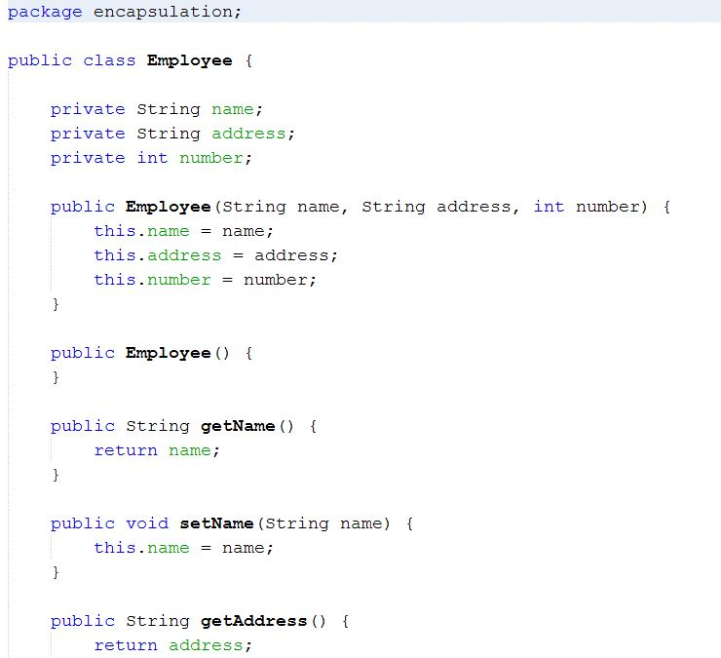
Encapsulation
Encapsulation is a process of binding or wrapping the data and the codes that operates on the data into a single entity. This keeps the data safe from outside interface and misuse. One way to think about encapsulation is as a protective wrapper that prevents code and data from being arbitrarily accessed by other code defined outside the wrapper.

Slide 13
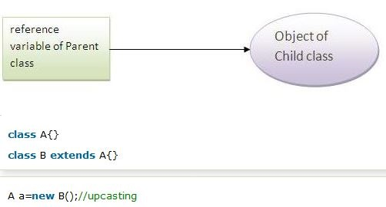

Up casting and down casting
When reference variable of Parent class refers to the object of Child class, it is known as upcasting.
Its opposite when variable of child class refers to the object og parent class. Its known as down casting

Slide 14
Association
Association is relation between two separate classes which establishes through their Objects. Association can be one-to-one, one-to-many, many-to-one, many-to-many.
In Object-Oriented programming, an Object communicates to other Object to use functionality and services provided by that object. Composition and Aggregation are the two forms of association.

Slide 15
Aggregation
It represents Has-A relationship.
It is a unidirectional association i.e. a one way relationship. For example, department can have students but vice versa is not possible and thus unidirectional in nature.
In Aggregation, both the entries can survive individually which means ending one entity will not effect the other entity

Slide 16
Composition
Composition is a restricted form of Aggregation in which two entities are highly dependent on each other.
It represents part-of relationship.
In composition, both the entities are dependent on each other.
When there is a composition between two entities, the composed object cannot exist without the other entity.

